Slide 1
Lending Club Case Study
Author: Kumar Krishna Chakraborty

Slide 2
Business Problem Statement
A consumer finance company is specialised in lending various types of loans to urban customers. When the company receives a loan application, the company must decide for loan approval based on the applicant’s profile. Two types of risks are associated with the bank’s decision
If the applicant is likely to repay the loan, then approving the loan results in a loss of business to the company
If the applicant is not likely to repay the loan, i.e. he/she is likely to default, then approving the loan may lead to a financial loss for the company

Slide 3
Business Objective
The company wants to understand the driving factors (or driver variables) behind loan default, i.e., the variables which are strong indicators of default. The company can utilise this knowledge for its portfolio and risk assessment
Solution Approach
Exploratory Data Analysis was used to identify the key consumer and loan attributes that influence the tendency of loan default

Slide 4
Univariate Analysis (Single Attribute impact) Key Observations
We observed the trend that higher the loan amount, the chances of loan default is more
We observed that higher is the interest, greater is the chance of loan default.
We observed that higher instalment amounts show higher default percentages.
We observed that higher annual income show lesser default percentages
We observed that higher debt to income ratio show higher default percentages
We observed that total credit revolving balances slightly influence the default percentage. Higher the revolving balance, greater the chance of the loan getting defaulted
We observed that revolving line utilization rate has high impact to the loan default percentage. When this increases, the charged off percentage also increases.

Slide 5
Univariate Analysis (Single Attribute impact) Key Observations
We observed that loan repayment term plays a factor in predicting the default rate
We observe that for G, F, E and D form grades, the default rate is much higher than others
We observe that the G3 and F5 sub grades have default rate greater than 40%. This field is a clear indicator of the default percent
We observe that Verified applicants have higher loan default percentage. Hence we infer that there is gap in the verification process
We observed that loans taken for small_business, renewable_energy and educational have higher risks associated with it in terms of loan default
We observed that NE, NV, SD, AK, FL, MO states show higher risks of loan default
We observed that applicants with non-zero derogatory public records have greater chances of loan default
We observed that higher is the number of public bankruptcy records, greater is the chance of loan default.
We observed that the December month has the highest number of loan applications per year and the biggest default ratio. This is festive season. Month of May is also another one, which is during the summer break and right before the Memorial day and Independence day breaks in US

Slide 6
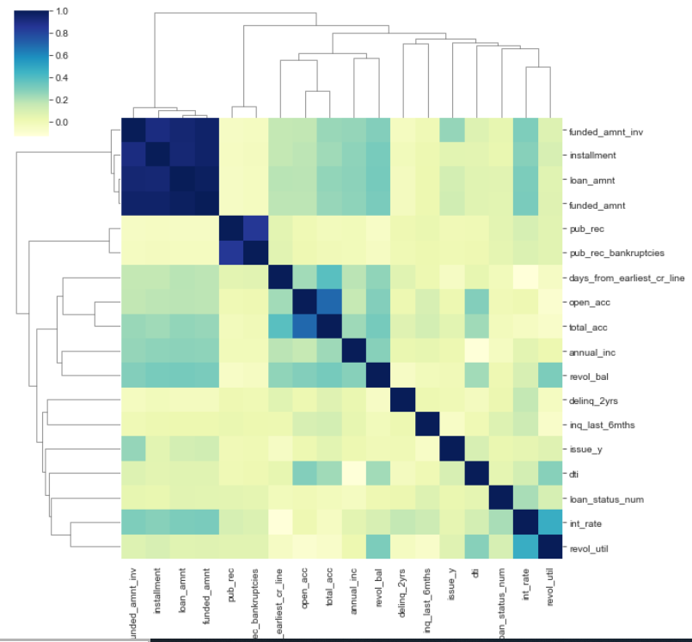
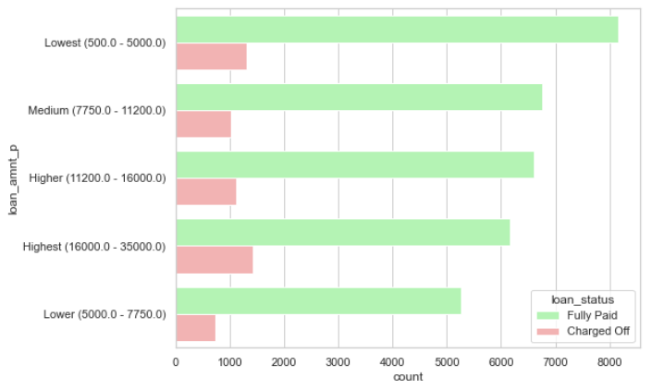
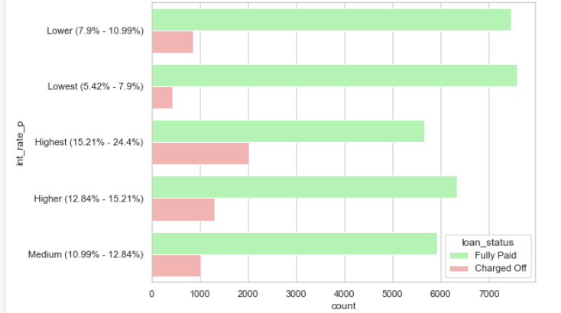
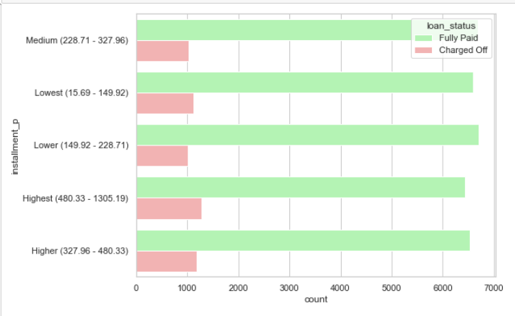
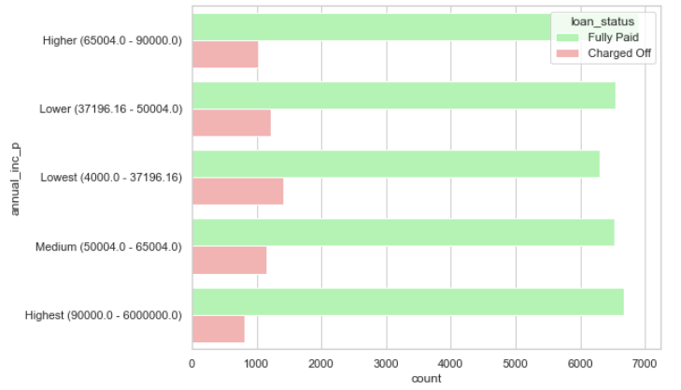
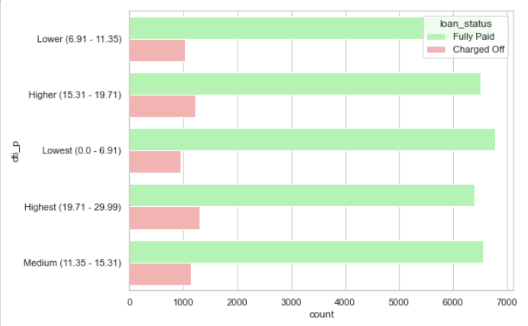
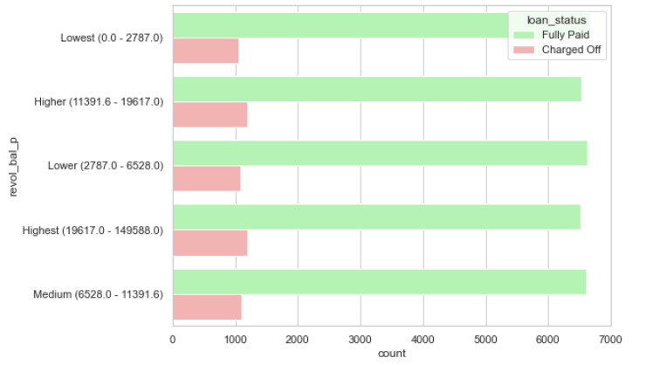
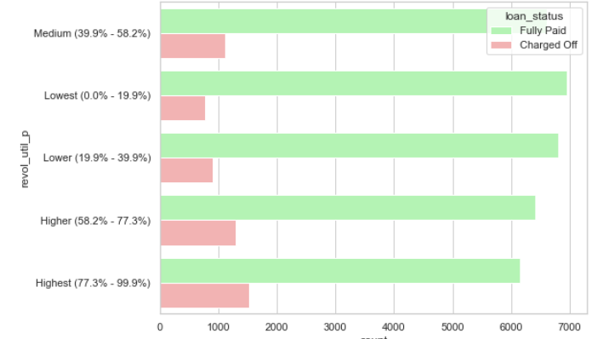
Univariate Analysis: Reference graphs

Slide 7
Bivariate Analysis (Combined attribute impact) Key Observations
We observed that loan repayment term plays a factor in predicting the default rate
We observed that higher instalments for any income group have more number of loan defaults
We observe that greater is the correlation of addr_state with the purpose of the loan, the greater is the chance of loan default
By comparing the annual income with loan purpose we observed that small business loans for lowest and medium income groups have high chances of loan default. Also renewable energy loans for higher income group show the same trend.
When we compare annual income with debt-to-income group, we observe that medium debt-to-income group in the lowest income range shows high trend of loan default

Slide 8
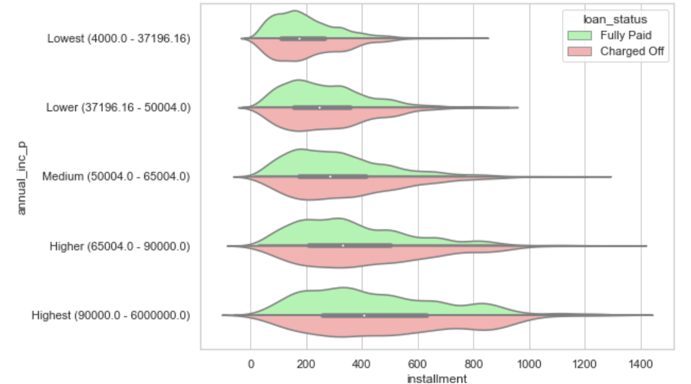
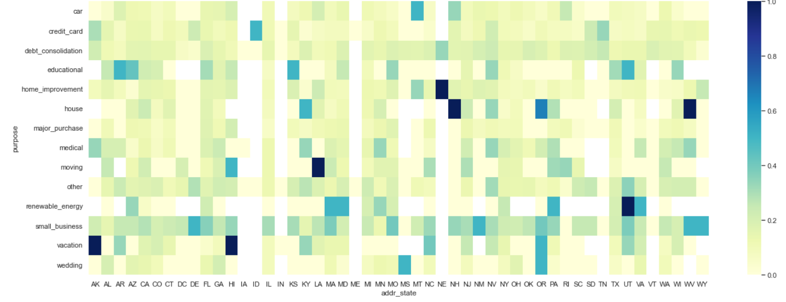
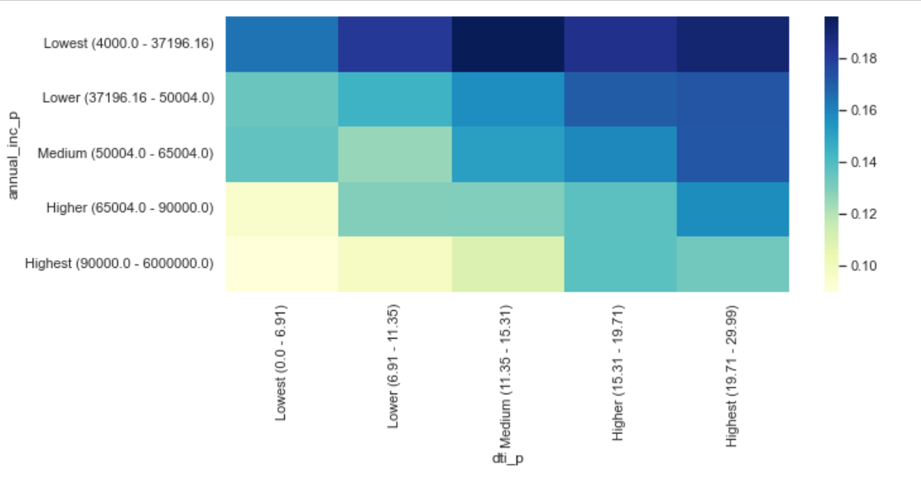
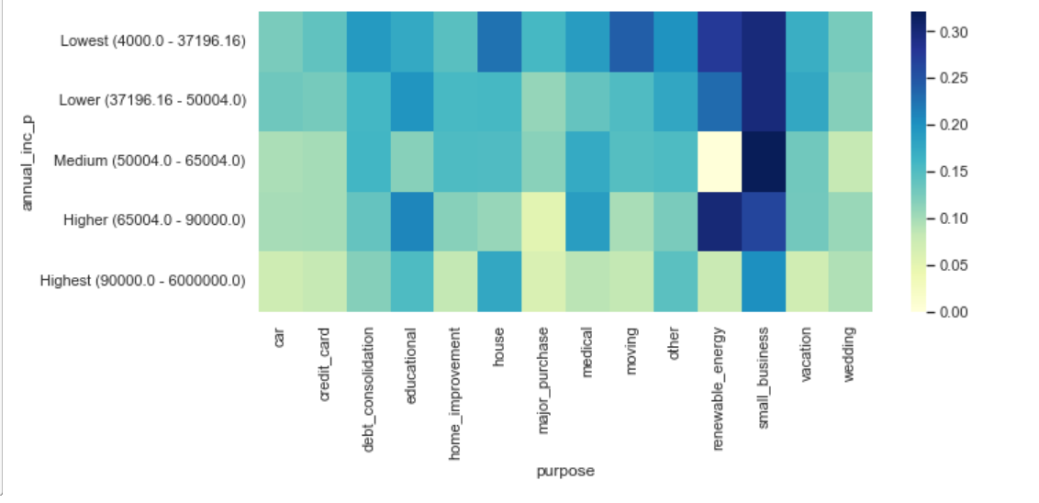
Bivariate Analysis: Reference graphs

Slide 9
Final conclusion
We have categorized our results under 2 categories
  Attributes showing lesser impact to the trend of loan default
  Attributes showing higher impact to the trend of loan default
Lesser impact
  Lower annual income (below 37000)
  Higher loan amount (above 16000)
  Higher debt to income ratio (above 15%)
  Higher instalment amount (above 327)
  Loan issue month (Dec, May)
  Applicant’s address state (NV, SD, AK, FL)
Higher impact
  Higher interest rate (above 13%)
  Repayment term (5 years)
  Loan purpose (small business, renewable energy, educational)
  Higher revolving line utilization rate (above 58%)
  Loan grade & sub-grade (D to G)
  Public bankruptcy records (1 or 2)
  Derogatory public records (1 or 2)
  Missing employment record

Slide 10
Final conclusion
In terms of the effects of combined attributes on the tendency of loan default, we observe that the following show higher combined impact
  High loan amount and interest rate for lower income group
  High instalment and longer repayment term
  Residential state and loan purpose
  Income group and loan purpose
  Home ownership (other) and loan purpose (car, moving or small business)
Few Recommendations
  The company should be very cautious in approving loans with high amount and interest rates to lower income group applicants
  The company can structure the loans in a manner to avoid high instalment and longer repayment terms.
  The company should be careful in approving small business loans to low and medium income groups. The same aspect applies to renewable energy loans for high income group also. The verification process should be more stringent in these cases.
  The company should not approve loans for applicants for whom there are no proper employment records.
  The company should try to avoid approving loans to applicants having Derogatory public records and Public bankruptcy records (1 or 2)
  The company should revisit applicant verification process and rectify it to make it more accurate. We had observed that verified applications have more tendency to loan default.

